Slide 1
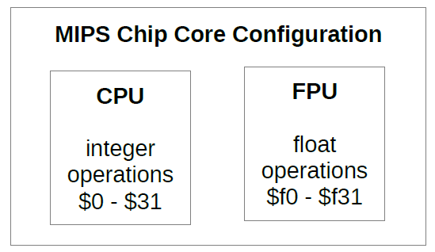
FP Instructions in MIPS
FP hardware is coprocessor 1
Adjunct processor that extends the ISA
Also called FPU co-processor

Slide 2
FP Instructions in MIPS
Separate FP registers
32 single-precision: $f0, $f1, … $f31
Paired for double-precision: $f0/$f1, $f2/$f3,
FP instructions operate only on FP registers
Programs generally don’t do integer ops on FP data, or vice versa
More registers with minimal code-size impact
Separate FP instructions for single/double precision
Single precision: (.s extension)
Double precision: (.d extension)

Slide 3
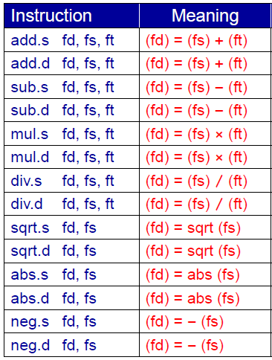
FP Arithmetic Instructions

Slide 4
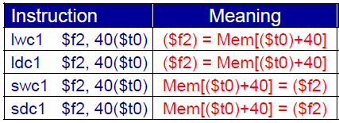
FP Load/Store Instructions
Separate floating point load/store instructions
lwc1: load word coprocessor 1
ldc1: load double coprocessor 1
swc1: store word coprocessor 1
sdc1: store double coprocessor 1

Slide 5
FP Load/Store pseudo instructions
l.s = lwc1 (load FP single)
s.s = swc1 (store FP single)
l.d = ldc1 (load FP double)
s.d = sdc1 (store FP double)

Slide 6
Loading immediate value
load immediate pseudoinstruction.
li.s fd, value # load register $fd with val
Example:
li.s $f1,1.0 # $f1 = constant 1.0
li.s $f2,2.0 # $f2 = constant 2.0
li.s $f10,1.0e-5 # $f10 = 0.00001

Slide 7
FP Data Movement Instructions
Moving data between general purpose and FP registers
mfc1: move from coprocessor 1 (to general purpose register)
mtc1: move to coprocessor 1 (from general purpose register)
Moving data between FP registers
mov.s: move single precision float
mov.d: move double precision float = even/odd pair of registers

Slide 8
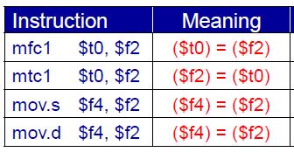
FP Data Movement Instructions

Slide 9
FP Convert Instructions
Convert instruction: cvt.x.y
Convert to destination format x from source format y
Supported formats
Single precision float = .s (single precision float in FP register)
Double precision float = .d (double float in even-odd FP register)
Signed integer word = .w (signed integer in FP register)

Slide 10
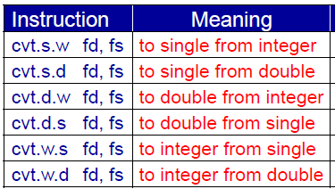
FP Convert Instructions

Slide 11
FP Compare and Branch Instructions
FP unit (co-processor 1) has a condition flag
Set to 0 (false) or 1 (true) by any comparison instruction
Three comparisons:
equal, less than, less than or equal
Two branch instructions based on the condition flag

Slide 12
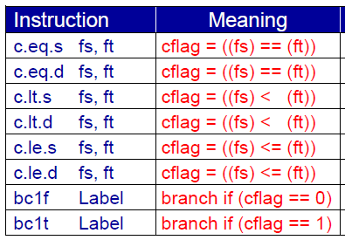
FP Compare and Branch Instructions

Slide 13
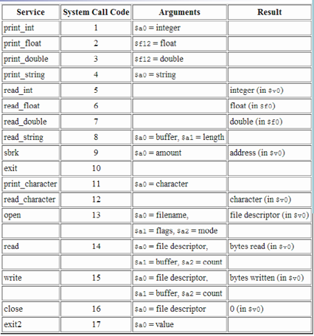
Reading and printing single and double values

Slide 14
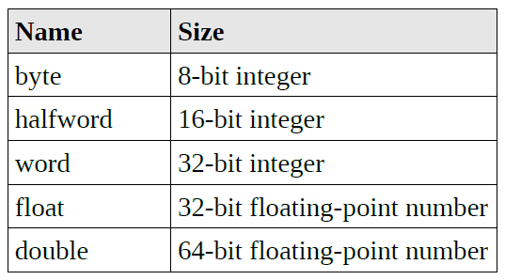
Datatypes

Slide 15

Floating-Point Data Declarations
The above declarations are used to define floating-point variables "pi" to a 32-bit floating-point value initialized to 3.14159 and "tao" to a 64-bit floating-point values initialized them to 6.28318

Slide 16
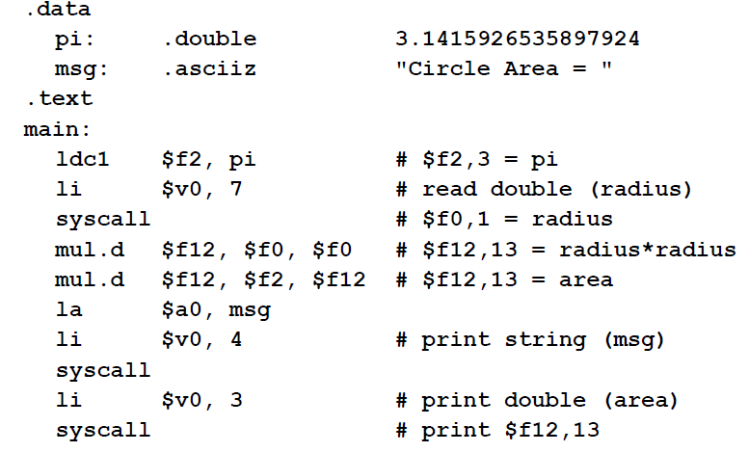
Example:1 Area of a Circle

Slide 17
Example 2: °F to °C
C code:
float f2c (float fahr) { return ((5.0/9.0)*(fahr - 32.0)); }
.text
.globl main
main:
l.s $f16, const5
l.s $f18, const9
div.s $f16, $f16, $f18
l.s $f12, constf
l.s $f18, const32
sub.s $f18, $f12, $f18
mul.s $f12, $f16, $f18
li $v0, 2
syscall
li $v0, 10
syscall
.data
const5: .float 5.0
const9: .float 9.0
const32: .float 32.0
constf: .float 50.0

Slide 18
Example 3: ax^2 + bx + c for user-input x
.data
a: .float 1.0
bb: .float 2.0
c: .float 3.0
msg: .asciiz "Enter x: "
blank: .asciiz " "
newl: .asciiz "\n"
.text
.globl main

Slide 19
main: # read input
la $a0,msg # prompt user for x
li $v0,4 # print string
syscall
li $v0,6 # read single
syscall # $f0 <-- x
# evaluate the quadratic
l.s $f2,a # sum = a
mul.s $f2,$f2,$f0 # sum = ax
l.s $f4,bb # get b
add.s $f2,$f2,$f4 # sum = ax + b
mul.s $f2,$f2,$f0 # sum = (ax+b)x = ax^2 +bx
l.s $f4,c # get c
add.s $f2,$f2,$f4 # sum = ax^2 + bx + c

Slide 20
# print the result
mov.s $f12,$f2 # $f12 = argument
li $v0,2 # print single
syscall
la $a0,newl # new line
li $v0,4 # print string
syscall
li $v0,10 # code 10 == exit
syscall # Return to OS.

